Slide 1
Computer Graphics
by
Dr. Metwally Rashad

Slide 2
Chapter 1
Computer Graphics
Input and Video Display Devices
1/20

Slide 3
Input Devices
• Keyboards, Button Boxes, and Dials
• Mouse Devices
• Trackballs and Spaceballs
• Joysticks
• Data Gloves
• Digitisers
• Image Scanners
• Touch Panels
• Light Pens
• Voice Systems
2/20

Slide 4
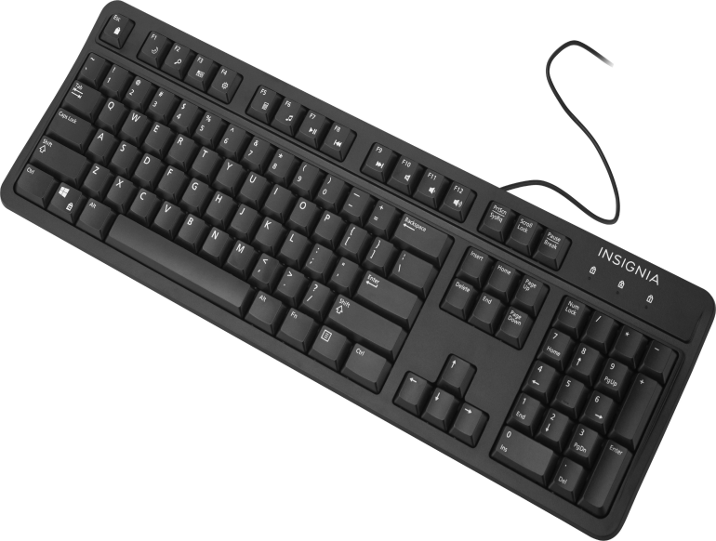
Input Devices
Keyboards, Button Boxes, and Dials
An alphanumeric keyboard on a graphics system is used primarily as a device for entering text strings, issuing certain commands, and selecting menu options.
Input to a graphics application may come from a set
of buttons, dials, or switches that select data values
or customized graphics operations.
3/20

Slide 5
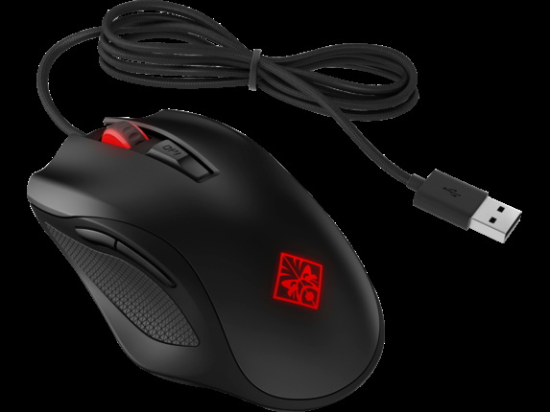
Input Devices
Mouse Devices
A mouse is a small handheld unit that is usually moved around on a flat surface to position the screen cursor.
One or more buttons on the top of the mouse provide
a mechanism for communicating selection information to
the computer; wheels or rollers on the bottom of the
mouse can be used to record the amount and direction of
movement.
4/20

Slide 6
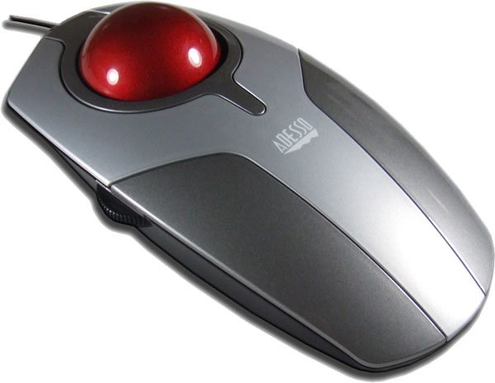
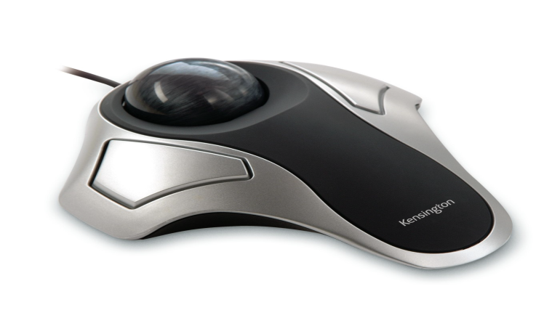
Input Devices
Trackballs and Spaceballs
A trackball is a ball device that can be rotated with
the fingers or palm of the hand to produce screen-cursor
movement.
An extension of the two-dimensional trackball
concept is the spaceball, which provides six degrees
of freedom. Unlike the trackball, a spaceball does not
actually move.
5/20

Slide 7
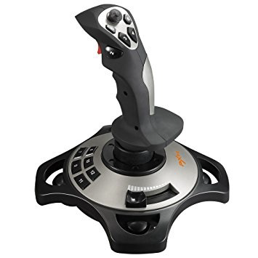
Input Devices
Joysticks
Another positioning device is the joystick, which
consists of a small, vertical lever (called the stick)
mounted on a base.
We use the joystick to steer the screen
cursor around. Most joysticks select screen
positions with actual stick movement;
others respond to pressure on the stick.
6/20

Slide 8
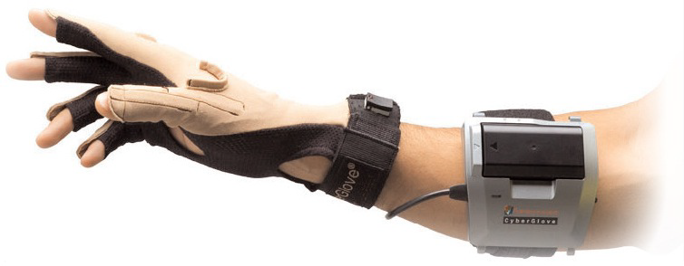
Input Devices
Data Gloves
Data glove is a device that fits over the user’s hand and can be used to grasp a “virtual object.”
The glove is constructed with a series of sensors that detect hand and finger motions.
7/20

Slide 9
Input Devices
Digitizers
A common device for drawing, painting, or interactively selecting positions is a
digitizer.
These devices can be designed to input coordinate
values in either a 2D or a 3D space.
One type of digitizer is the graphics tablet
(also referred to as a data tablet), which is used
to input two-dimensional coordinates by activating
a hand cursor .
8/20

Slide 10
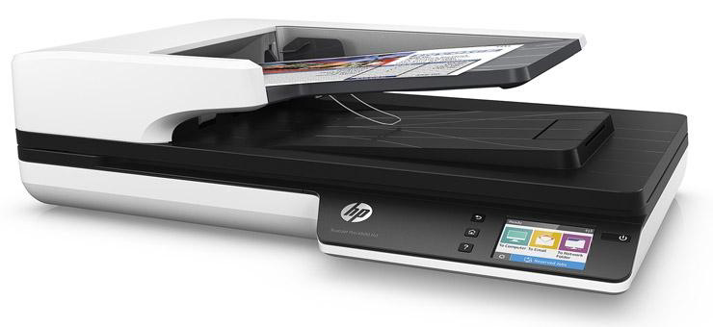
Input Devices
Image Scanners
Drawings, graphs, photographs, or text can be stored for computer processing with an image scanner by passing an optical scanning mechanism over the information to be stored.
9/20

Slide 11
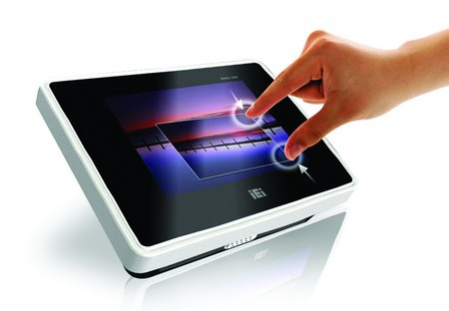
Input Devices
Touch Panels
Touch panels allow displayed objects
or screen positions to be selected with
the touch of a finger.
10/20

Slide 12
Input Devices
Light Pens
Light pens are pencil-shaped devices are used
to select screen positions by detecting the
light coming from points on the CRT screen.
11/20

Slide 13
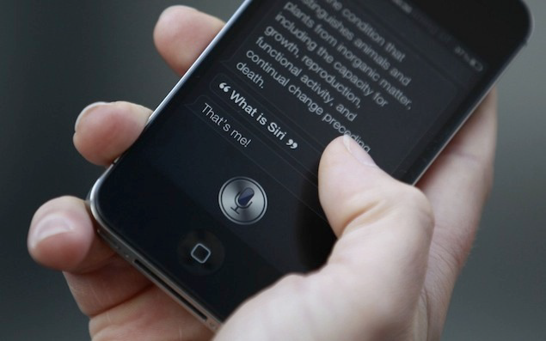
Input Devices
Voice Systems
Speech recognizers are used with some graphics
workstations as input devices for voice commands.
The voice system input can be used to initiate
graphics operations or to enter data. These systems
operate by matching an input against a predefined
dictionary of words and phrases.
12/20

Slide 14
Video Display Devices
• Refresh Cathode-Ray Tubes
• Raster-Scan Displays
• Random-Scan Displays
• Color CRT Monitors
• Flat-Panel Displays
• Three-Dimensional, Virtual Reality, Augmented Reality displays
13/20

Slide 15
Video Display Devices
The primary output device in a graphics system is a video monitor.
The operation of most video monitors was based on the standard
cathode-ray tube (CRT) design, but several other technologies exist.
In recent years, flat-panel displays have become significantly more popular due to their reduced power consumption and thinner designs.
14/20

Slide 16
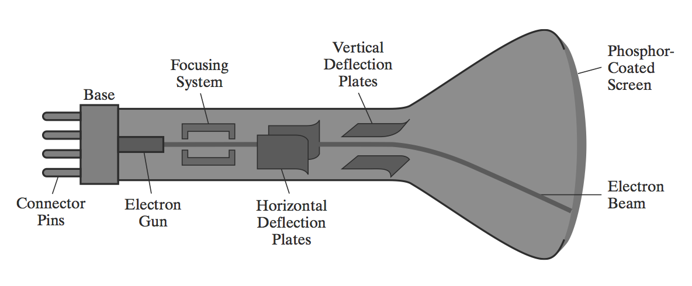
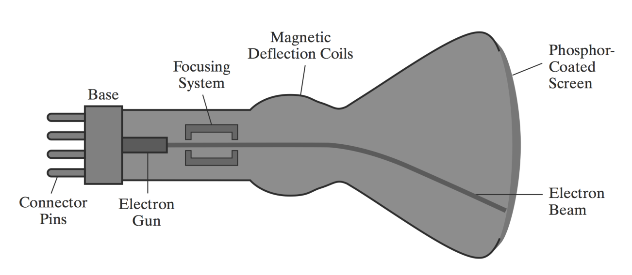
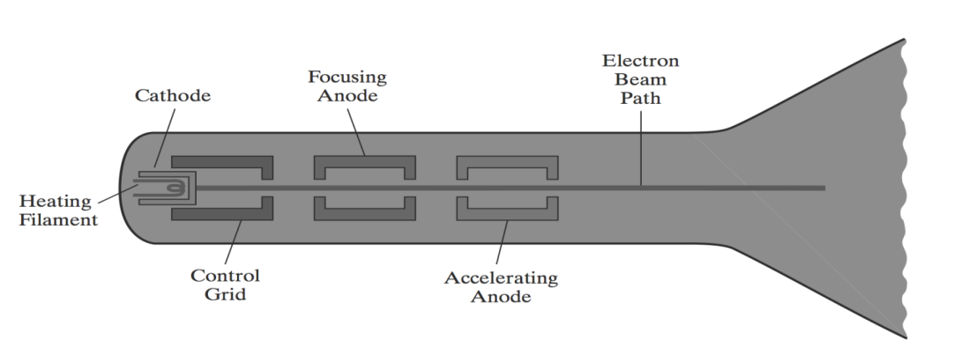
Video Display Devices
Refresh Cathode-Ray Tubes (CRT)
15/20

Slide 17
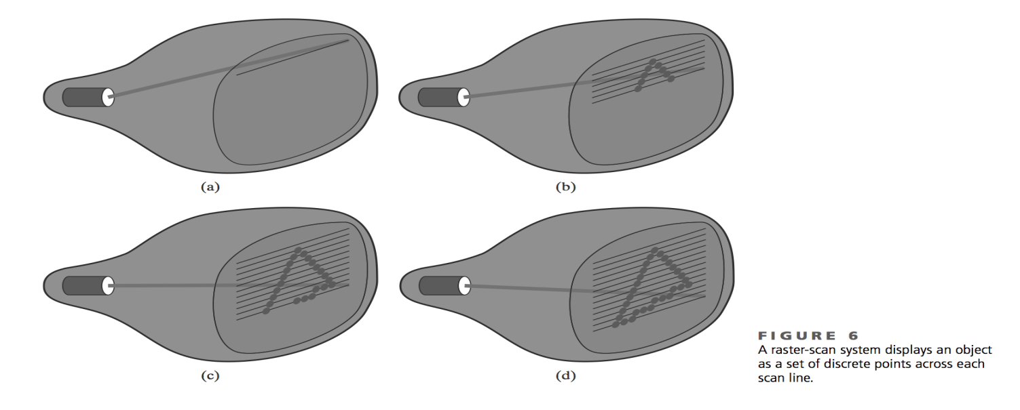
Video Display Devices
Raster-Scan Displays
The most common type of graphics monitor employing a CRT is the
raster-scan display, based on television technology.
16/20

Slide 18
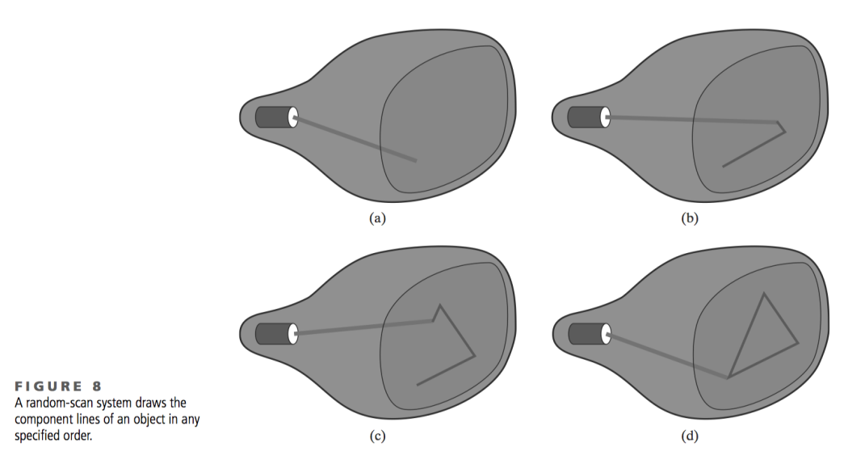
Video Display Devices
Random-Scan Displays
When operated as a random-scan display unit, a CRT has the electron beam directed only to those parts of the screen where a picture is to be displayed.
A random-scan system draws the
component lines of an object in
any specified order.
17/20

Slide 19
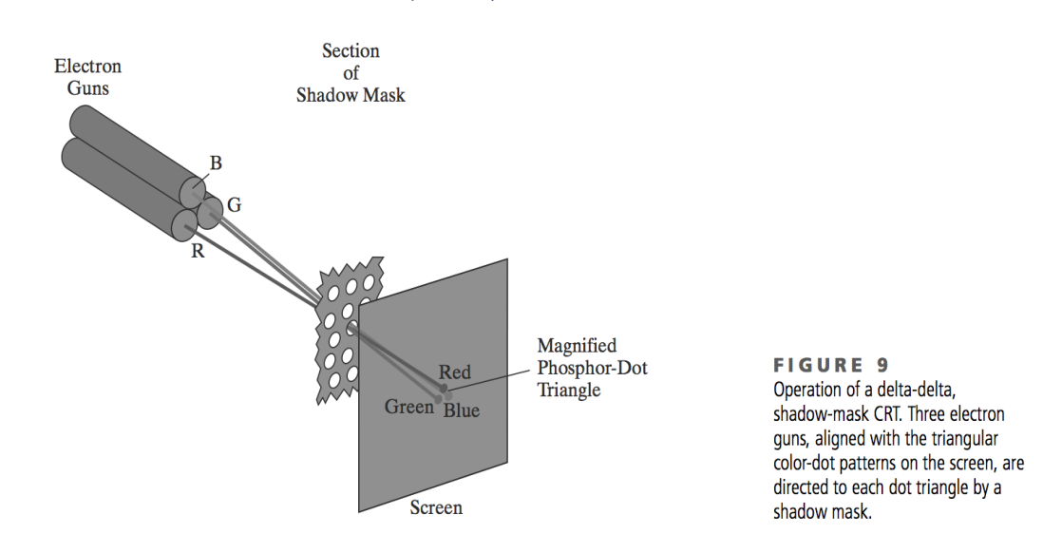
Video Display Devices
Color CRT Monitors
A CRT monitor displays color pictures by using a combination of phosphors that emit different-colored light.
18/20

Slide 20
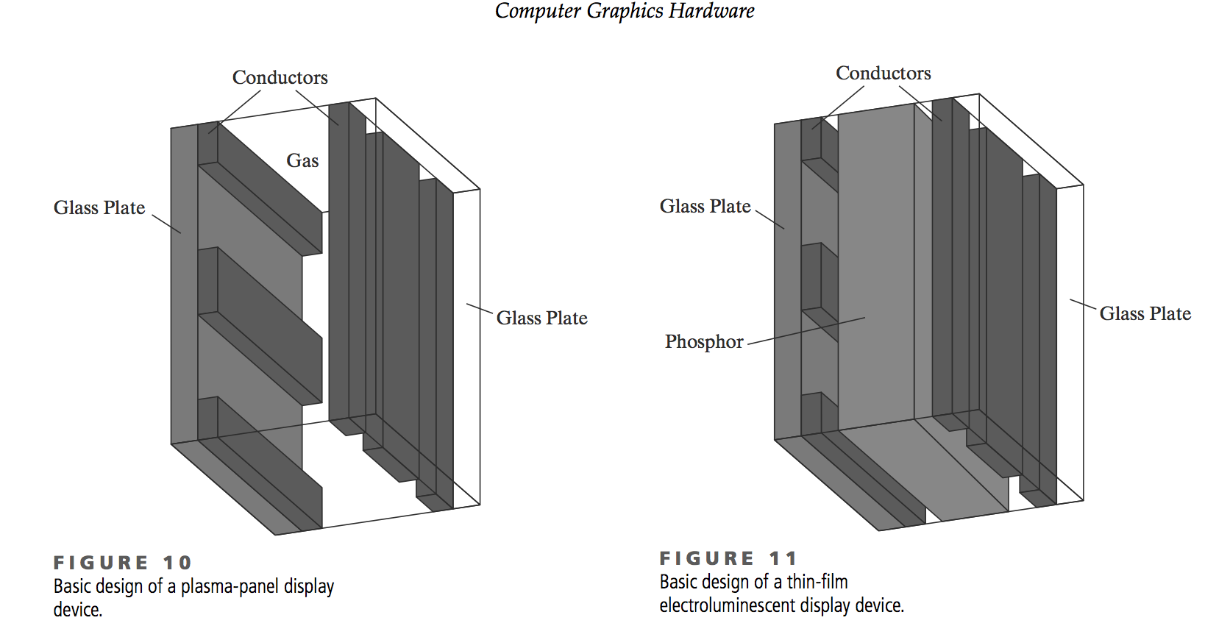
Video Display Devices
Flat-Panel Displays
The term flat-panel display
refers to a class of video
devices that have reduced
volume, weight, and power
requirements compared to
a CRT.
19/20

Slide 21
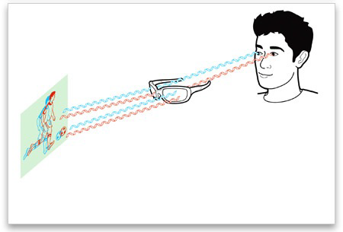
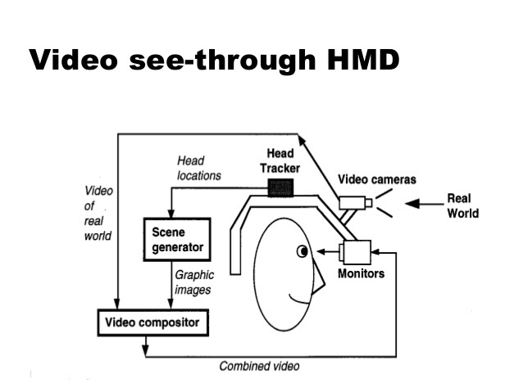
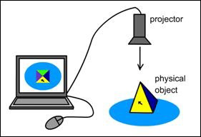
Video Display Devices
Three-Dimensional, Virtual Reality, Augmented Reality displays
20/20

